Slide 1
Transport Layer Protocols II
Course Code: CSC 3116
Course Title: Computer Networks
Dept. of Computer Science
Faculty of Science and Technology
Lecturer No: | 7 | Week No: | 9 | Semester: | Summer 22-23
Lecturer: | Shakila Rahman; Shakila.Rahman@aiub.edu

Slide 2
Lecture Outline
Congestion in networks
Congestion control
TCP Reno
Error control principle
Sliding window technique

Slide 3
Congestion in networks
Congestion
Congestion is a situation in a network in which the load on the network, the number of packets sent to the network, is greater than the capacity of the network, the number of packets a network can handle.
Congestion control
Congestion control refers to the mechanisms and techniques to control the congestion and keep the load below the capacity [1].

Slide 4
Congestion in networks…
Congestion in a network or internetwork occurs because routers and switches have queues-buffers that hold the packets before and after processing.
A router, for example, has an input queue and an output queue for each interface.
When a packet arrives at the incoming interface, it undergoes three steps before departing:
1. The packet is put at the end of the input queue while waiting to be checked.
2. The processing module of the router removes the packet from the input queue once it reaches the front of the queue and uses its routing table and the destination address to find the route.
3. The packet is put in the appropriate output queue and waits its turn to be sent.

Slide 5
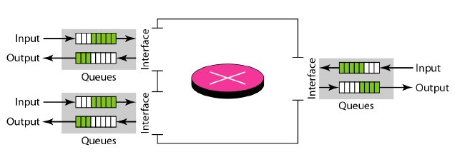
Congestion in networks…
Two possible scenarios in a router:
Packet arrival rate > packet processing rate,
the input queues become longer and longer.
2. Packet departure rate < Packet processing rate,
the output queues become longer and longer

Slide 6
Congestion Control
Terminology
Congestion Window
The number of bytes the sender may have in the network at any time [2]
LastByteSent – LastByteAcked <= cwnd
Sending Rate
The congestion window size divided by the round-trip time (RTT¹) of the connection [2].
By adjusting the value of cwnd, the sender can therefore adjust the rate at which it sends data into its connection [3].
1 The time from when a segment is sent until it is acknowledged.

Slide 7
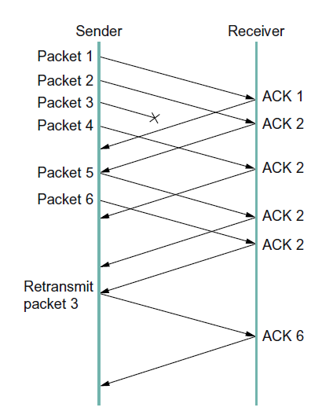
Congestion Control
Terminology
Loss Event
Timeout
Sender does not receive any acknowledgement within a predefined interval
3 duplicate Acknowledgement (3 duplicate ACK)
Reception of the same ACK four times.
Indicates that the channel is not congested that much
as the receiver is still receiving segments.
Indicates that the segment 3 is lost as it receives the duplicate
ACK 3
Receiver is receiving segment out of order.
ACK 2
ACK 3
ACK 3
ACK 3
ACK 3
ACK 7

Slide 8
Congestion Control
TCP Reno
Steps of congestion window control
Slow Start
Congestion Avoidance

Slide 9
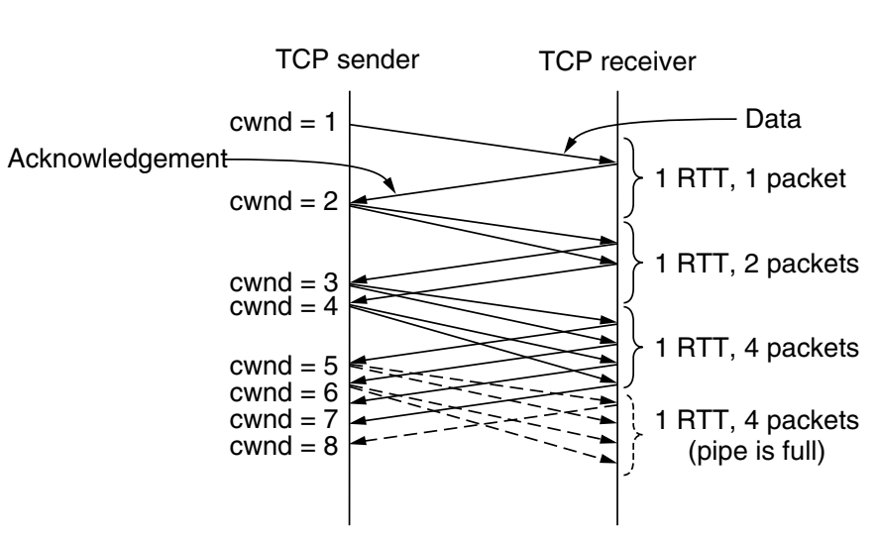
Congestion Control
TCP Reno
Slow Start
Follows a greedy approach.
Starts sending data of size equals maximum sized segment (MSS).
If it receives an ACK for the previous transmission by next RTT → it sends 2 MSS.
After next RTT, if it receives two ACKs → it sends 2+2=4 MSS in next round.
Fig. 1 Slow start from an initial congestion
window of one segment [2].

Slide 10
Congestion Control
TCP Reno
Slow Start (cont.)
That is, in each round, N+M MSS in a round if it sends N MSS in the last transmission round and receives M ACK before the current round.
If it receives ACK for all the N MSS (previously sent), it sends N+N MSS this round.
Fig. 1 Slow start from an initial congestion
window of one segment [2].

Slide 11
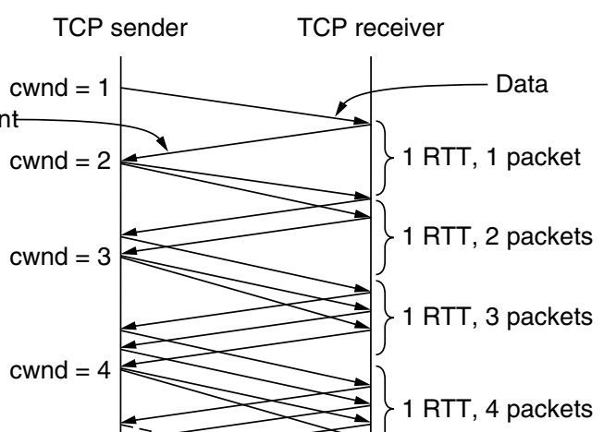

Congestion Control
TCP Reno
Congestion Avoidance
How long does cwnd continue to be increased exponentially?
$$if cwnd≥threshold$$
Increase cwnd by1 per transmission round
That is, increase cwnd linearly¹
Fig. 2 Linear increase of cwnd
1. Usually timeout and 3 duplicate ACK do not happen in slow start

Slide 12
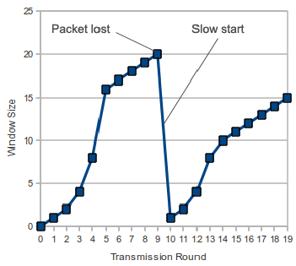


Congestion Control
TCP Reno
How long does cwnd continue to be increased linearly?
Timeout
Until one of two incidents happen
Timeout
3 duplicate ACK
Threshold
Timeout
$$Threshold=\frac{cwnd}{2}$$
$$cwnd=1 MSS$$
Fig. 3 Timeout
Start slow start

Slide 13
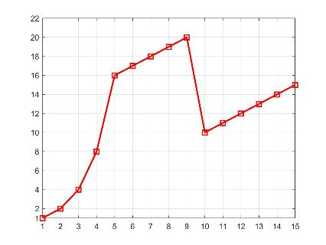


Congestion Control
TCP Reno
3 duplicate ACK
3-duplicate ACK
$$Threshold=\frac{cwnd}{2}$$
ssth
$cwnd=$ $Threshold$
cwnd
ssth
Start congestion avoidance
RTT
Fig. 4 3 duplicate ACK

Slide 14
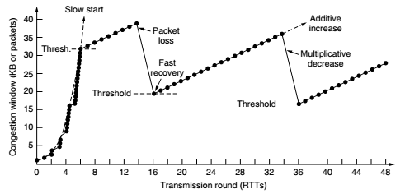
Congestion Control
TCP Reno
Fig. 5 TCP reno example

Slide 15
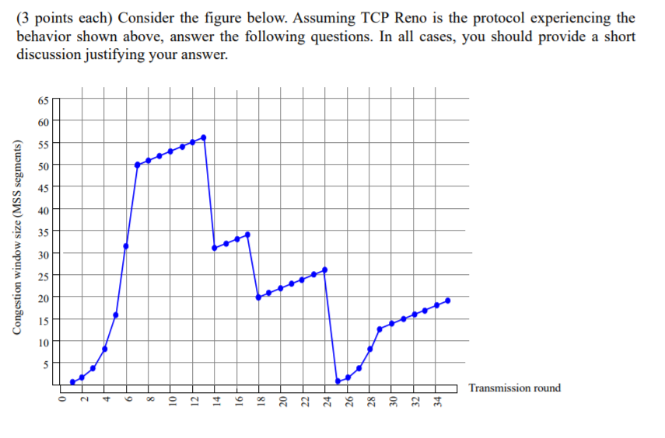
Find the Events in the TCP RENO. What are The Values Of Ssthresh And Cwnd at Each Event.

Slide 16
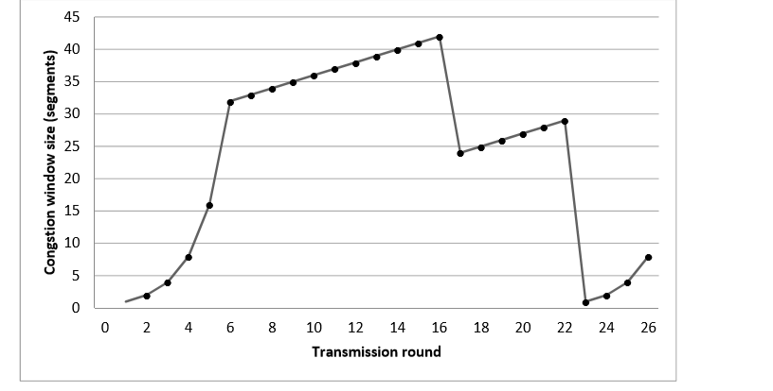
Homework
Identify Timeout/3 duplicate ACK incidence. Also identify slow start, congestion avoidance period.

Slide 17
Flow control
Send window
Sequence of byte numbers of which some are sent but yet to be acknowledged
while others are waiting to be sent
Maintained by sender
Receive window
Sequence of byte numbers which are expected to be received
Maintained by receiver

Slide 18
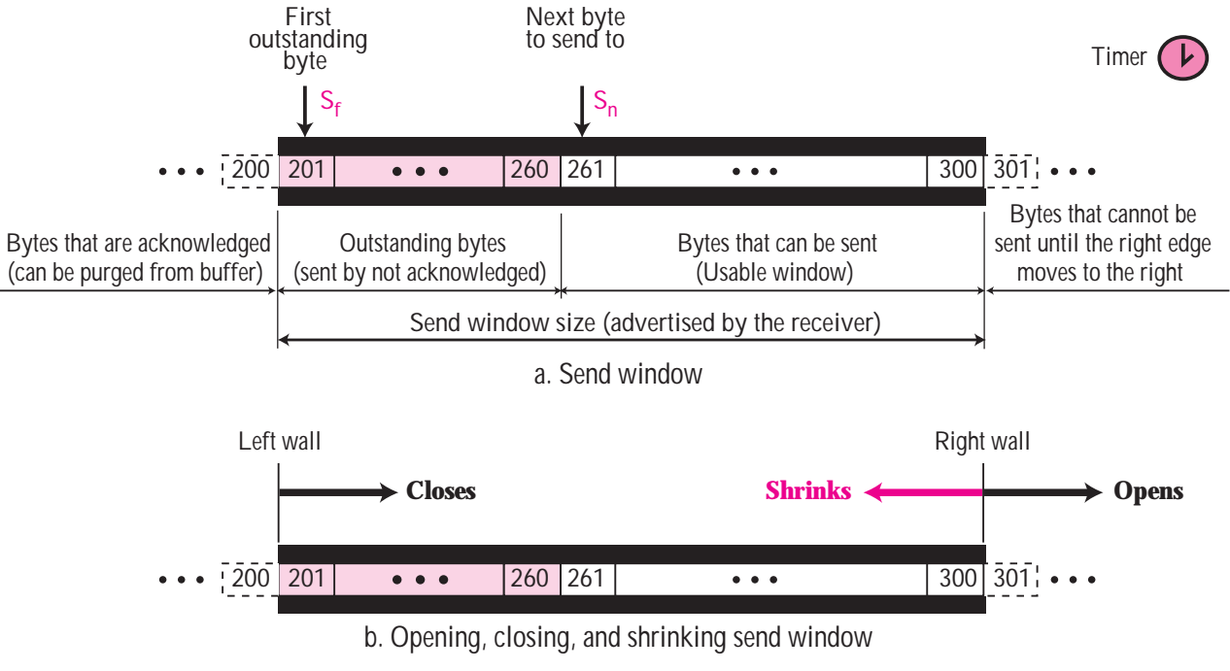
Flow control….
Send window
Opening and closing of send window

Slide 19
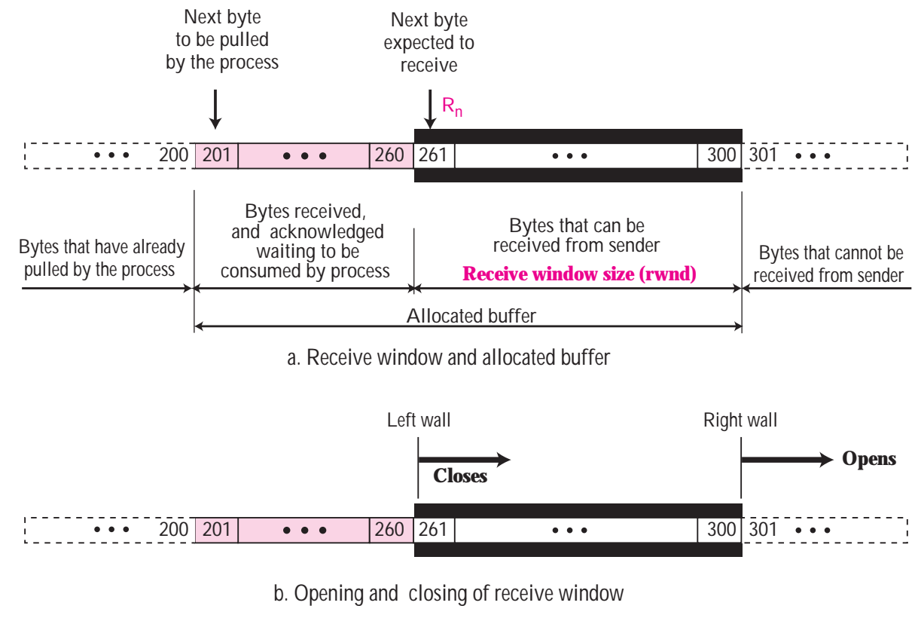
Flow control….
Receive window

Slide 20
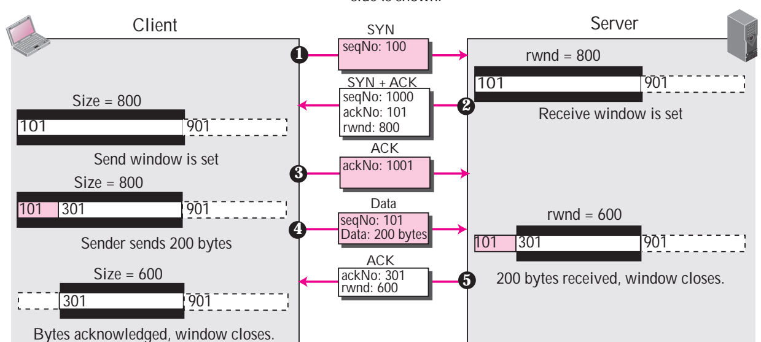
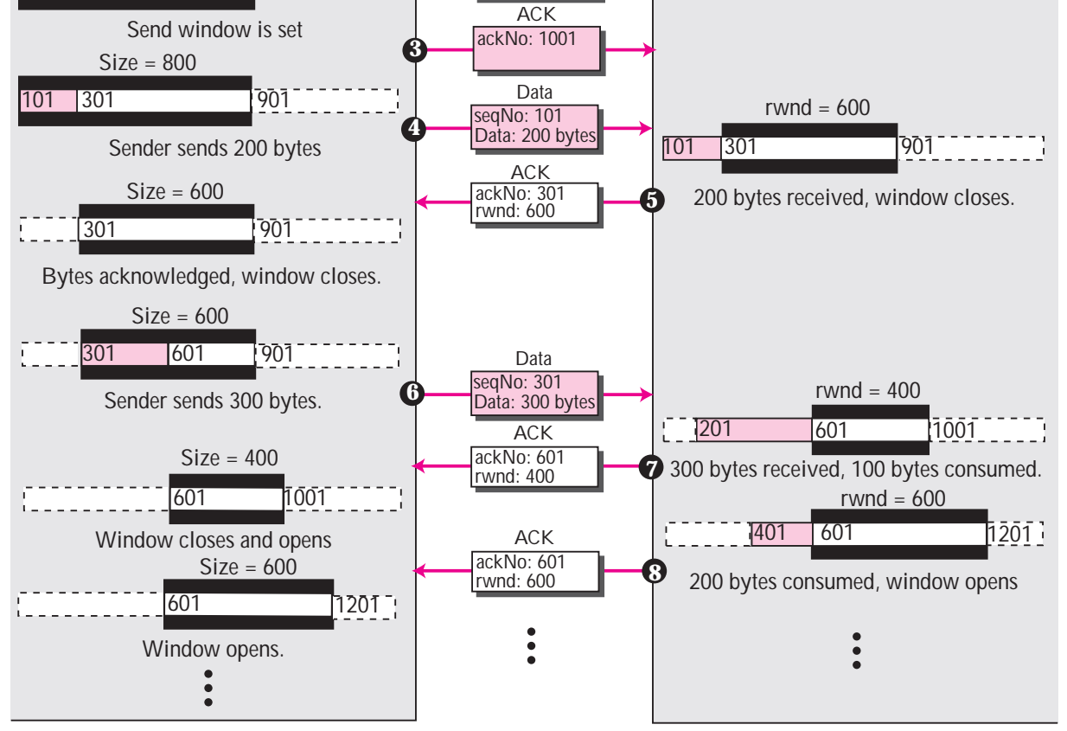
Flow control….
1. Client sends TCP connection request with SYN 100
a) Server sets the receive window size to buffer size of 800 bytes
2. Server sends SYN+ACK to client with ACK 101, own SYN 1000, its rwnd size 800
b) Client sets its window size to 800 bytes according to the received rwnd size
3. Client sends an ACK 1001
a
b

Slide 21
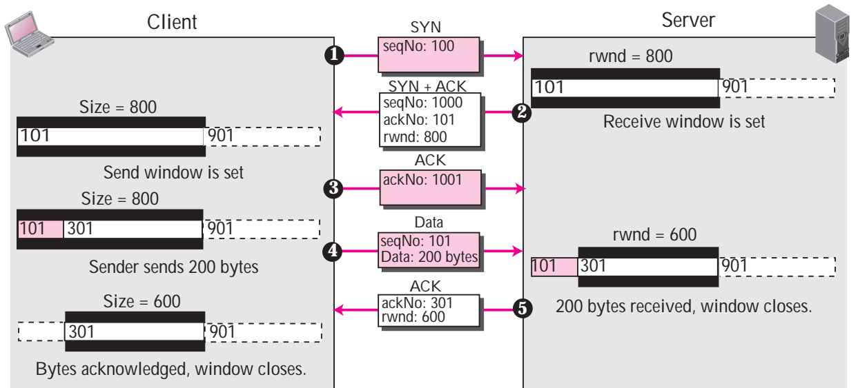
Flow control….
4. Client sends first 200 bytes (101 to 300) with Seq 101
c) Client marks 101 to 300 bytes sent but yet to be acknowledged.
d) Receiving 200 bytes, Server marks 101-300 bytes received and moves the left wall of
rwnd to 301, thereby shrinking rwnd from 800 bytes to 600 bytes (301-900).
5. Server sends ACK 301 with its current rwnd size 600.
e) Receiving ACK 301, client removes 100-300 bytes from send window and shrinks the
window between 301-900, thereby making the window of 600 bytes.
c
d
e

Slide 22
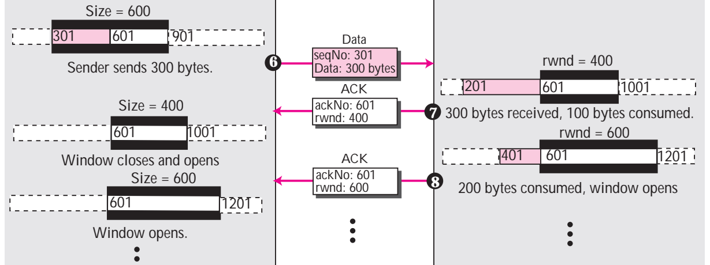
Flow control….
6. Client sends next 300 bytes from 301 to 600 with Seq 301.
f) Client marks 301-600 bytes sent but yet to be acknowledged
g) In receiver, first 100 bytes are pulled by upper layer.
Moves the right wall of rwnd by 100 byres to 1000
Receiving bytes 301-600, server marks 201-600 bytes as received.
Moves the left wall of rwnd to 601, thereby shrinking the rwnd to 400 bytes
7. Server sends ACK 601 with the recurrent rwnd size: 400.
f
g

Slide 23
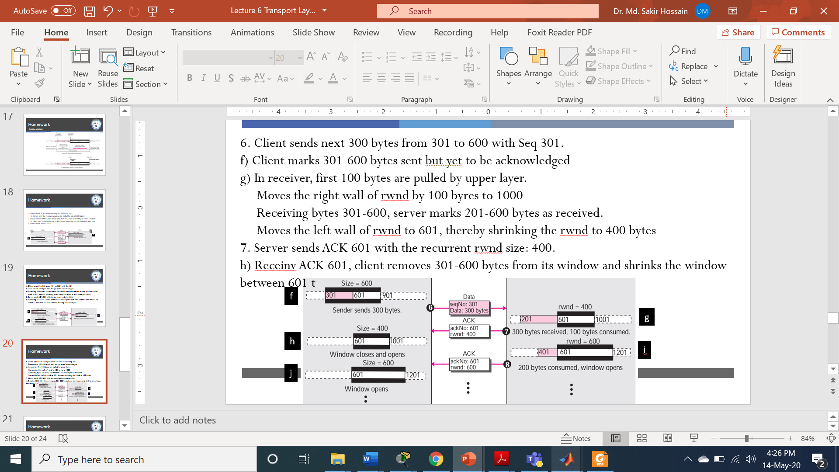
Flow control….
h) Receiving ACK 601, client removes 301-600 bytes from its window
To make window size 400, it moves left wall of window to 601 byte and right wall to 1000 byte
i) In server side, upper layer pulls 300 bytes from buffer.
Server removes 201-300 bytes from buffer.
Moves right wall of rwnd to 1200, thereby making the rwnd size 600 bytes.
8) Server sends the latest rwnd size to sender.
j) Sender moves the right wall of its window to 1200 to make the window size 600 as suggested by
the server [6].

Slide 24
References
[1] B. A. Forouzan, Data Communication and Networking, 4th ed., Tata McGraw Hill Companies, Inc., New Delhi, 2010, pp. 385.
[2] A. S. Tanenbaum and D. J. Wetherall, Computer Networks, 5th ed., Pearson
Education India, 2013, pp. 571-572.
[3] J. F., Kurose and K. W. Ross, Computer Networking: A Top-Down Approach, 7th ed.,
Pearson Education, Inc., USA, 2017, pp. 274-277.
[4] D. Medhi and K. Ramassamy, Network Routing Algorithms, Protocols and
Archtectures, 2nd ed., Elsevier Inc., 2018, pp. 607-608.
[5] D. Runemalm , D. M. Sarwar and M. Shalbaf, “Decreasing the Hybrid-ARQ bandwidth
overhead through the Multiple Packet NAK (MPN) protocol”,
https://www.researchgate.net/publication/267554658 , [Accessed: April. 22, 2020].
[6] B. A. Forouzan, TCP/IP Protocol Suite, 4th ed., McGraw Hill Companies, Inc., USA,
2010, pp. 457-462.

Slide 25
Recommended Books
Data Communications and Networking, B. A. Forouzan, McGraw-Hill, Inc., Fourth Edition, 2007, USA.
Computer Networking: A Top-Down Approach, J. F., Kurose, K. W. Ross, Pearson Education, Inc., Sixth Edition, USA.
Official Cert Guide CCNA 200-301 , vol. 1, W. Odom, Cisco Press, First Edition, 2019, USA.
CCNA Routing and Switching, T. Lammle, John Wily & Sons, Second Edition, 2016, USA.
TCP/IP Protocol Suite, B. A. Forouzan, McGraw-Hill, Inc., Fourth Edition, 2009, USA.
Data and Computer Communication, W. Stallings, Pearson Education, Inc., Tenth Education, 2013, USA.

